Slide 1
Boulder County Real Estate Statistics
October 2020
Presented by
Neil Kearney
Kearney Realty Co.
303-818-4055
Neil@KearneyRealty.com

Slide 2
Statistical Note
In October 2020 IRES MLS the facilitator of cooperation and the keeper of the data for Northern Colorado began sharing data again with REColorado the MLS for the Denver Metro Area. This data surge resulted in a jump in properties that are included in this report. The jump will even out over time but for now it’s difficult to know exactly how much of an effect this has on the data. Overall, the trends are still significant.

Slide 3
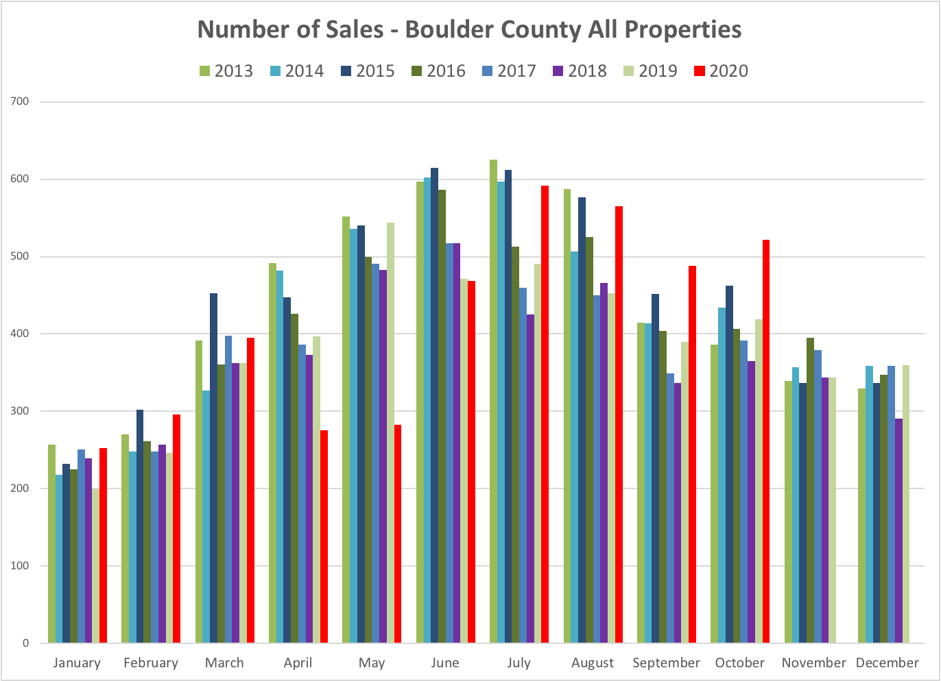
Monthly sales were again up 25% from the same month the previous year. YTD sales are now up 4% when compared to 2019. Take note of the statistical note regarding new data source this month which undoubtedly increased sales.

Slide 4
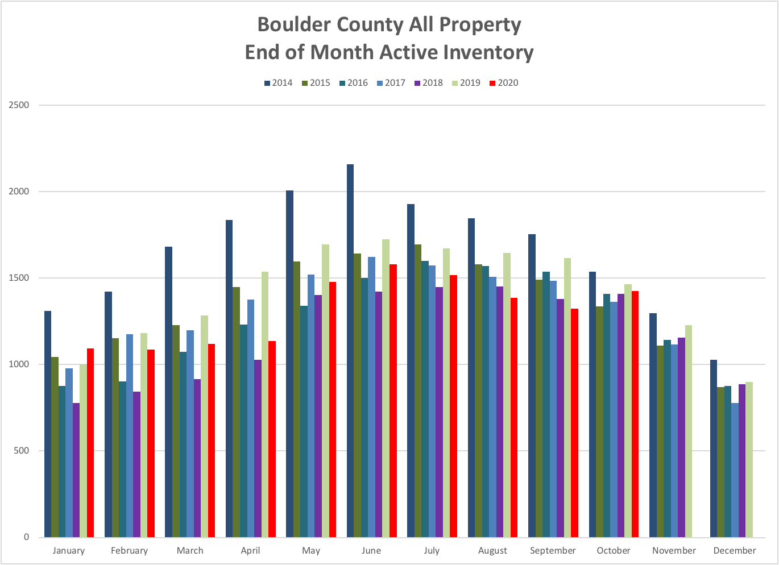
The market is seeing a surge in sales activity but not a commensurate increase in listings. Even with a few extra listings from REColorado the inventory level is still low compared to last year.

Slide 5
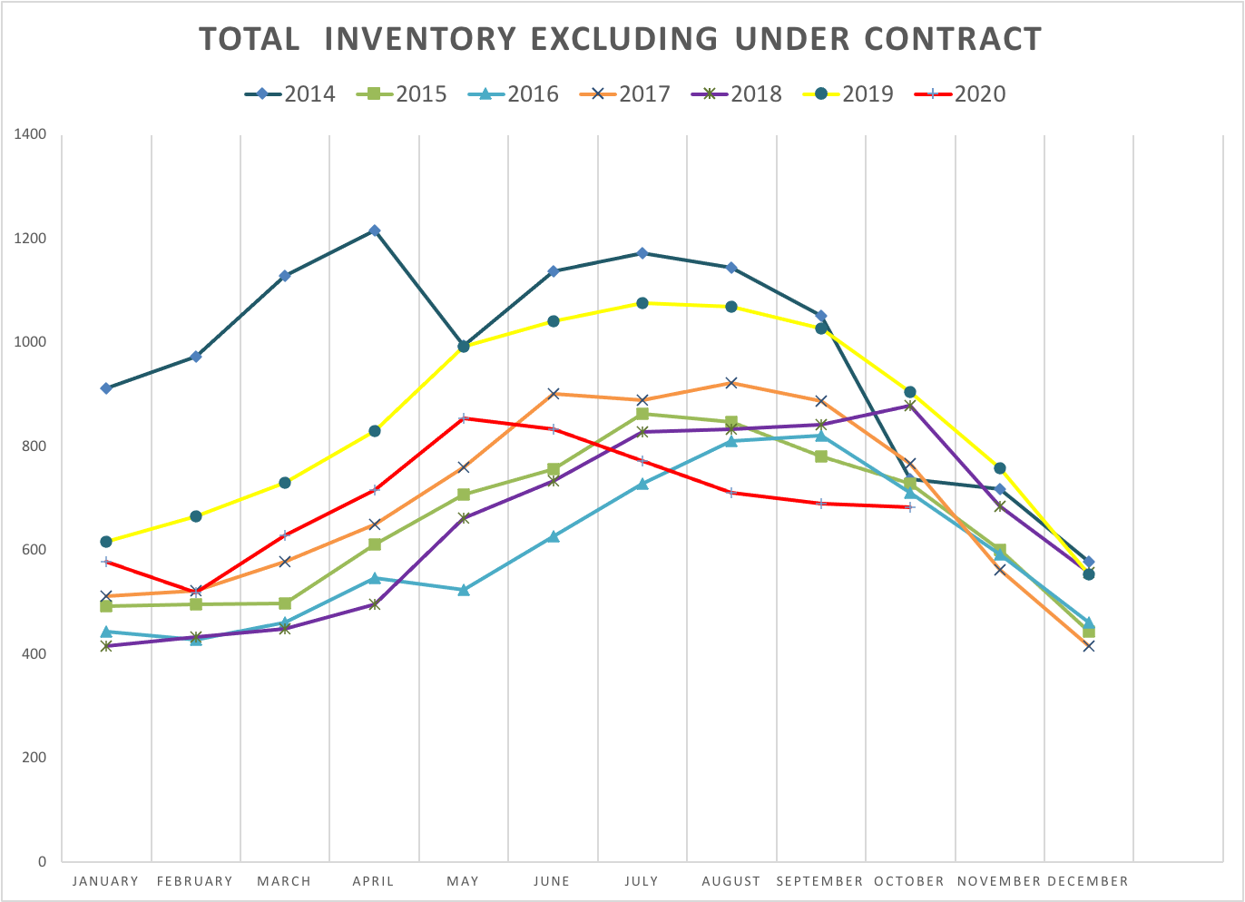
This graph shows the number of active homes on the market that are not already spoken for by a buyer at the time of reporting. At the end of September 52% of the properties in the MLS were already under contract. Strong sales are outpacing new listings.

Slide 6
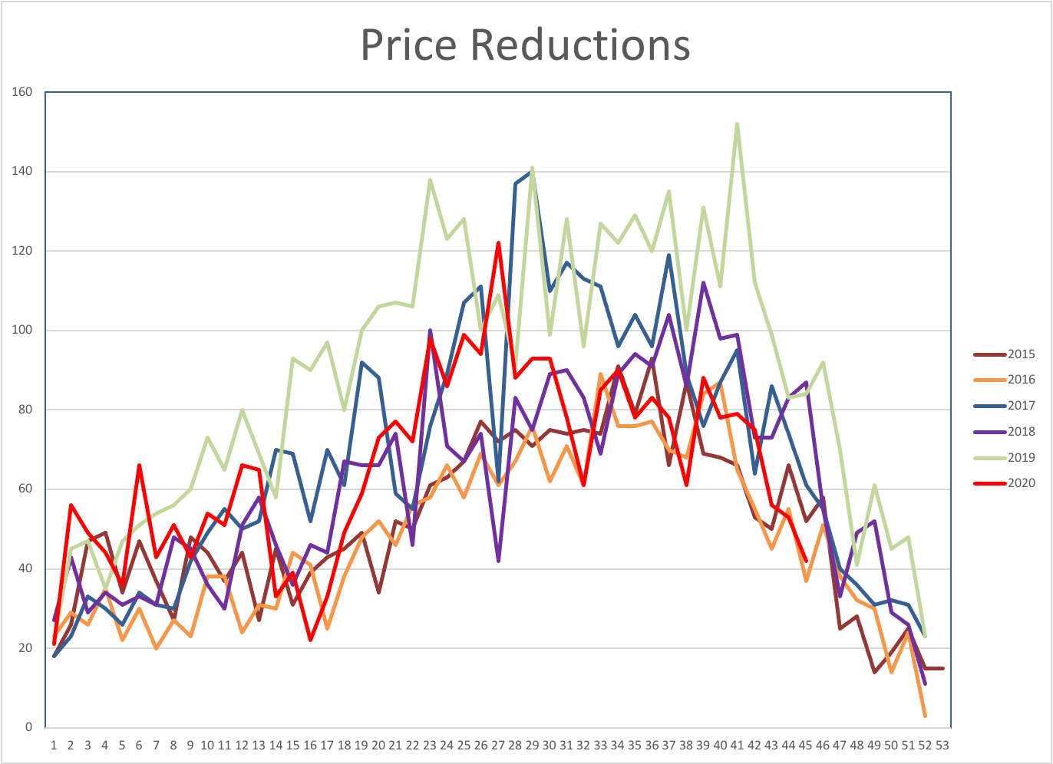
The number of price reductions have decreased over the last six weeks as the market activity has really increased.

Slide 7
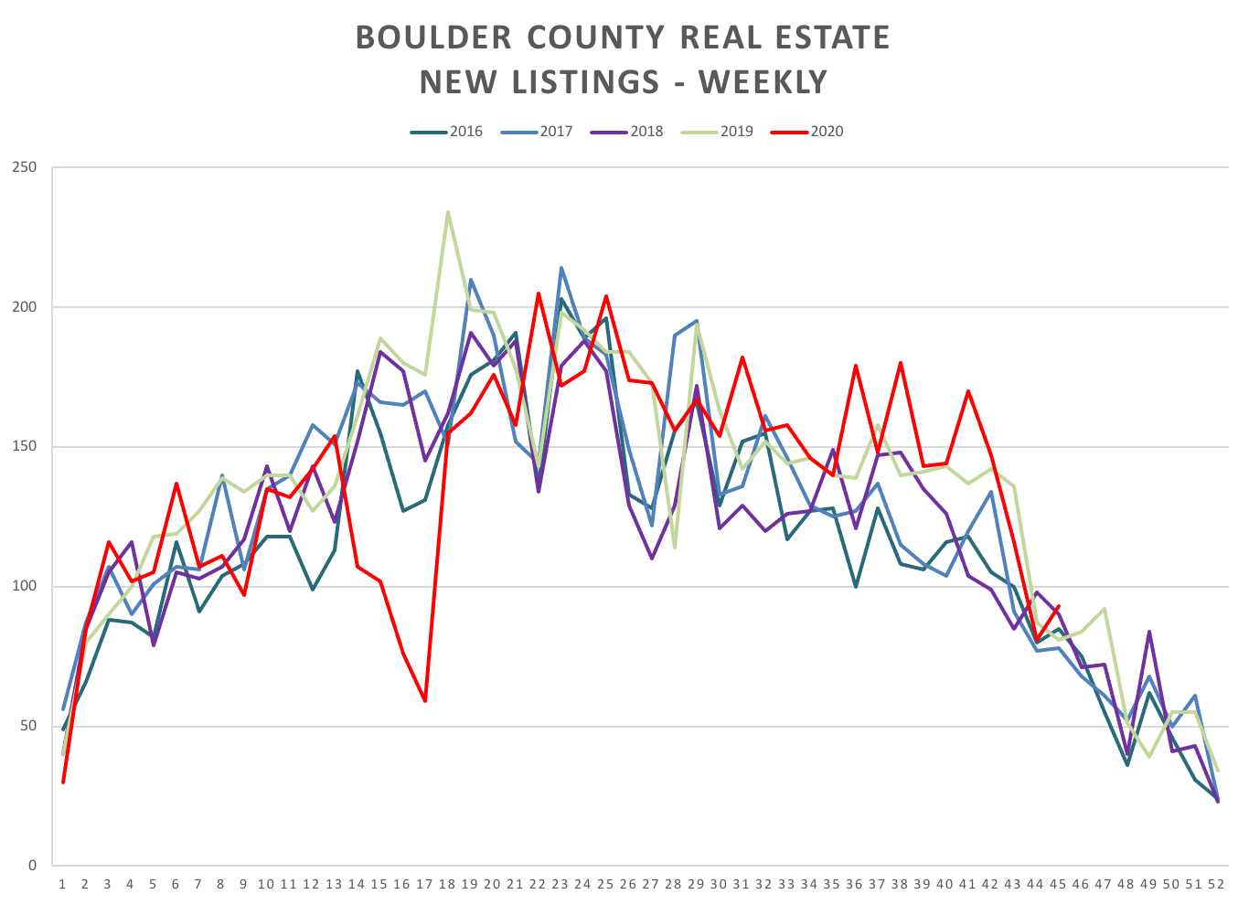
The red line shows new listings to the market in Boulder County so far in 2020. After a very strong September and October new listings have dropped off over the last few weeks.

Slide 8
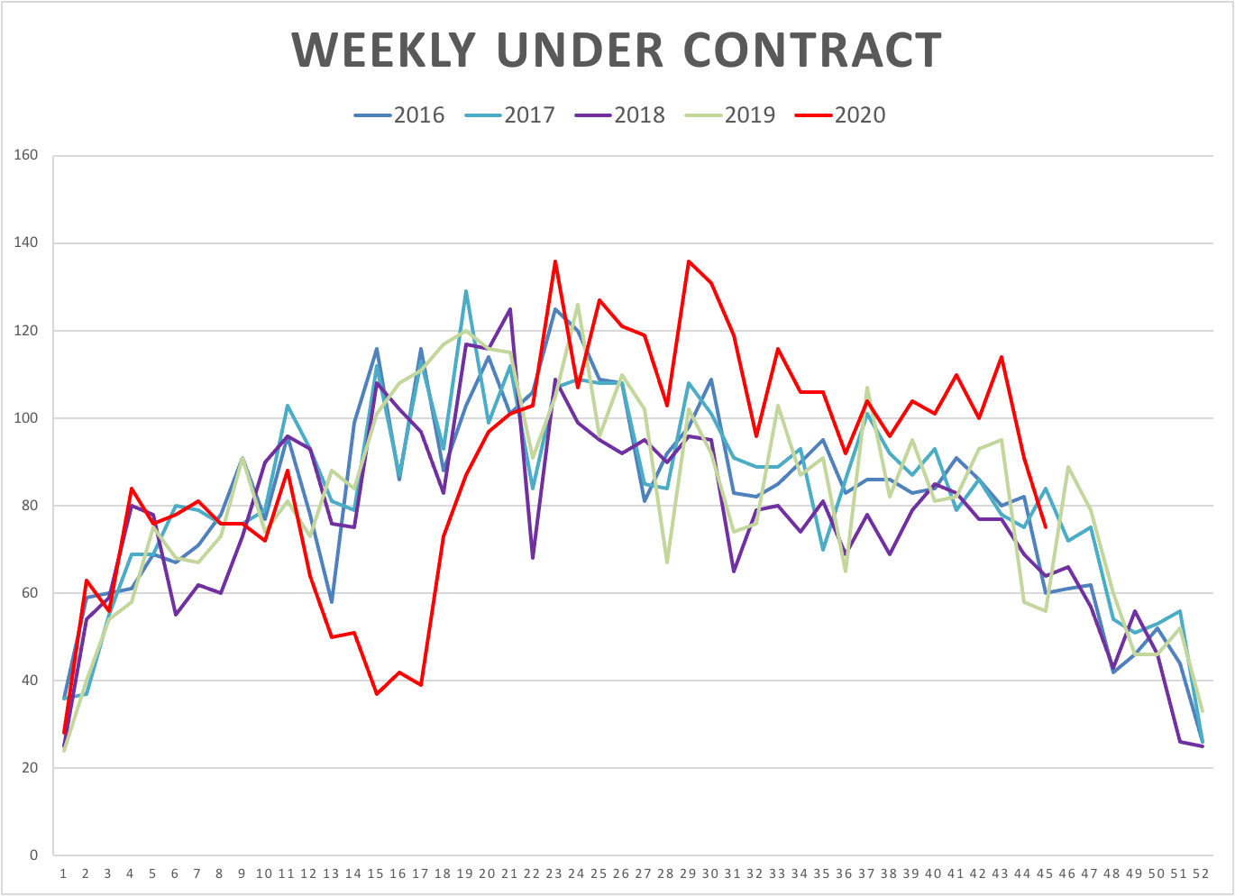
This chart shows the number of properties which have gone under contract each week throughout the year. A large drop during March and April has been followed by a very strong recovery that has continued through August. This is why our inventory is so low.

Slide 9
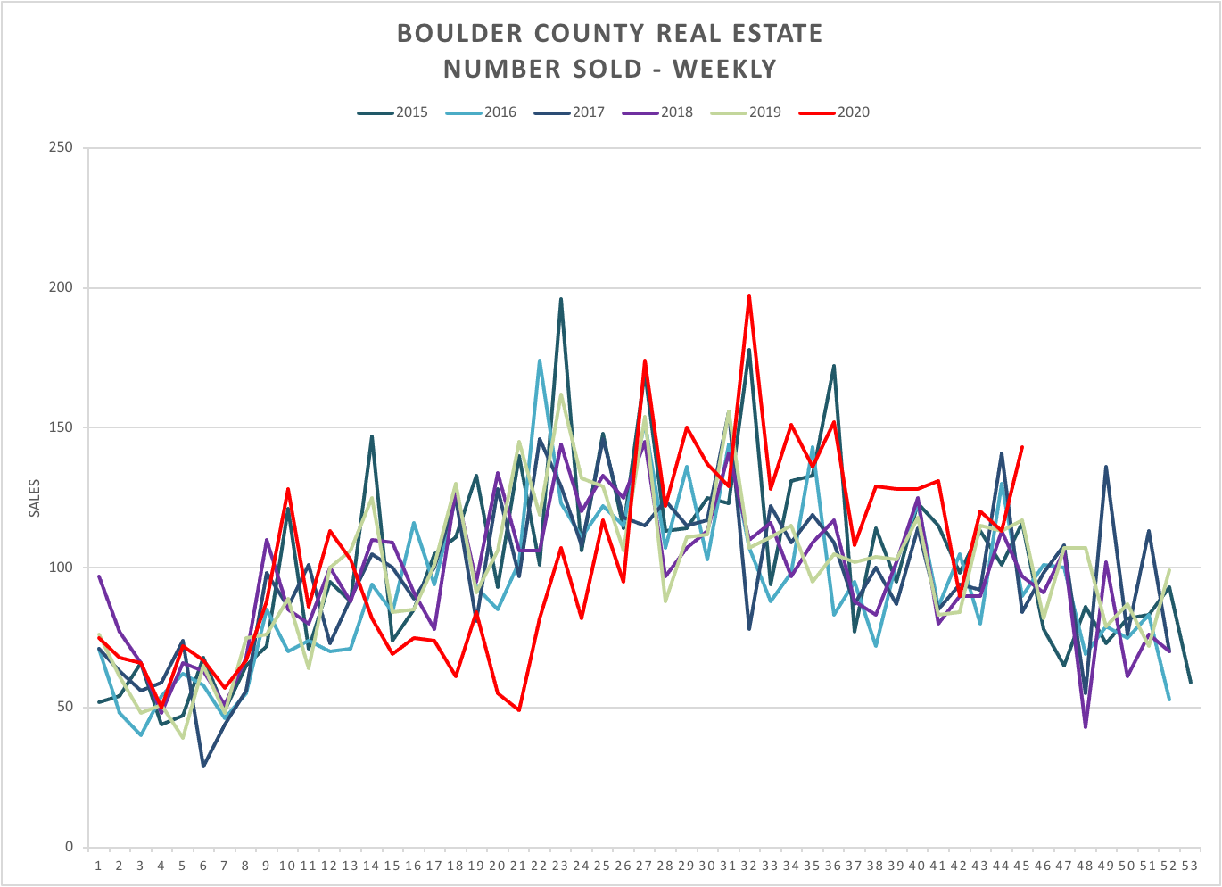
This graph shows the number of closings on a weekly basis. Monthly sales have been up significantly over the last few months.

Slide 10
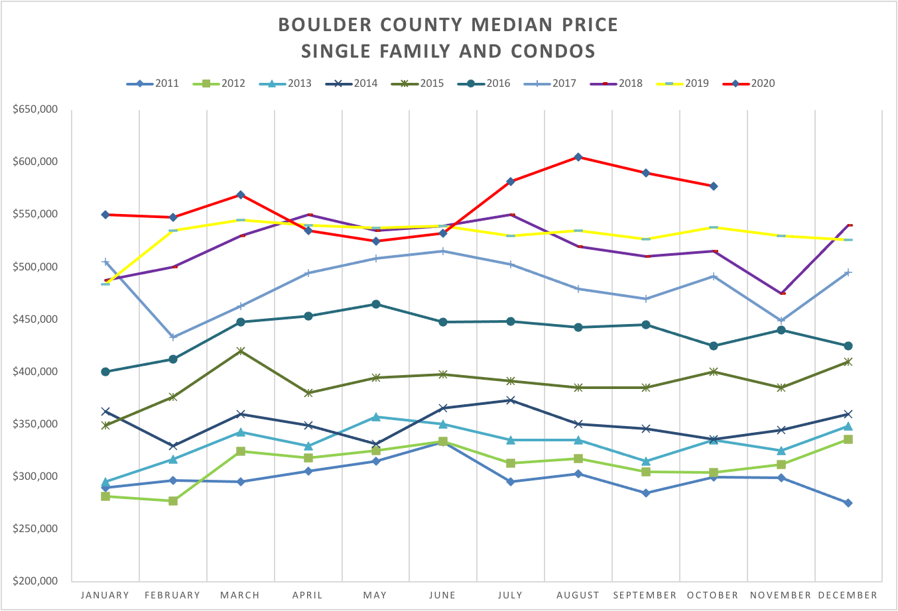
The market conditions of high demand and low supply have given prices a bump over the last three months.

Slide 11
My view of the Market
As we move towards the holidays and winter the local real estate market is still very strong. Consistent buyer demand has put sellers in a very good position. Multiple offers on well priced properties are common. We are still seeing a wave of out-of-town buyers in various stages coming to town. I expect that this wave to continue into the spring 2021 season. The pandemic is ramping up again which may make showings more difficult in some instances, but it hasn’t seemed to dampen buyer demand.
Copyright 2020 Neil Kearney, Kearney Realty Co.

